Slide 1


Bag-of-Words based
Image Classification (week I)
Joost van de Weijer

Slide 2
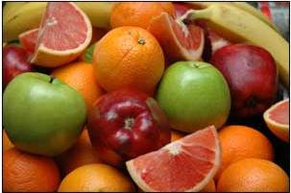
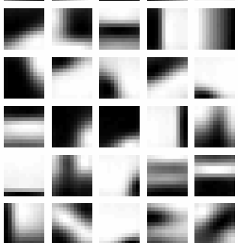
The Framework
1. Did changing the settings improve results ?
1. Feature
detection
4. BOW
Image
Image Representation
5. SVM/ distance measures
2. Extraction
shape
texture
color
image classification
image retrieval
3.Learn vocabulary
2. Do you use cross validation ?
Shape Voc
shape words
4.Can you visualize the words ?
3.What is the slowest part ?

Slide 3
Extra Assignment
I : Spatial Pyramids (I)
II : Opponent color SIFT (II)
III : Portmanteaux Vocabularies (III)
Answer the question: does it improve results for event classification ?
1. One extra assignment per group.

Slide 4
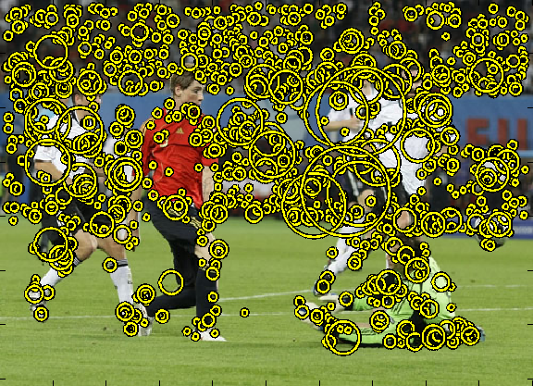
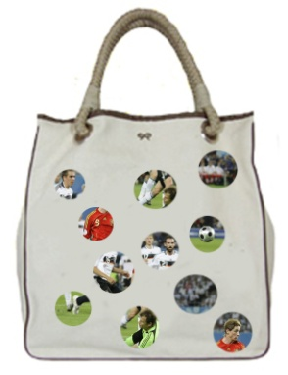
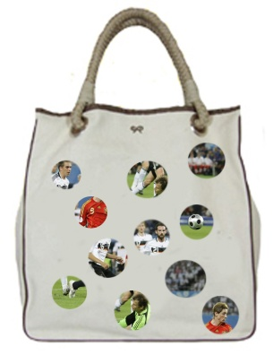


I : Spatial Pyramids
Spatial pyramyds have been proposed to allow for spatial relation ships between the visual words [Lazebnik 06].
{
...
...
}
At least some spatial information is coded in the BOW representation !

Slide 5
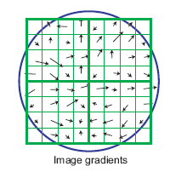
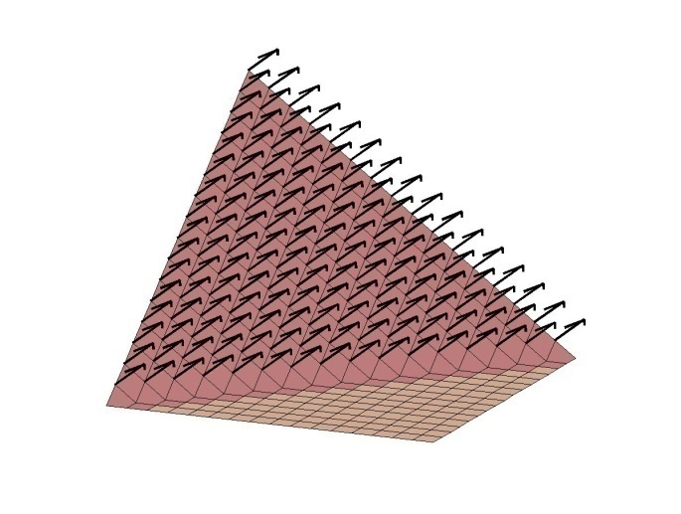
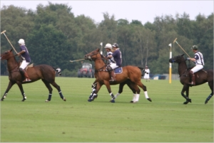
II : Opponent color SIFT
The ColorSift combines photometric invariance theory and the SIFT descriptor [Van der Sande 09].
O1
opponent colors
B
G
O2
R
easy way to combine color and SIFT.
others: only use SIFT on luminance (can use other methods to incorporate color).
O3

Slide 6
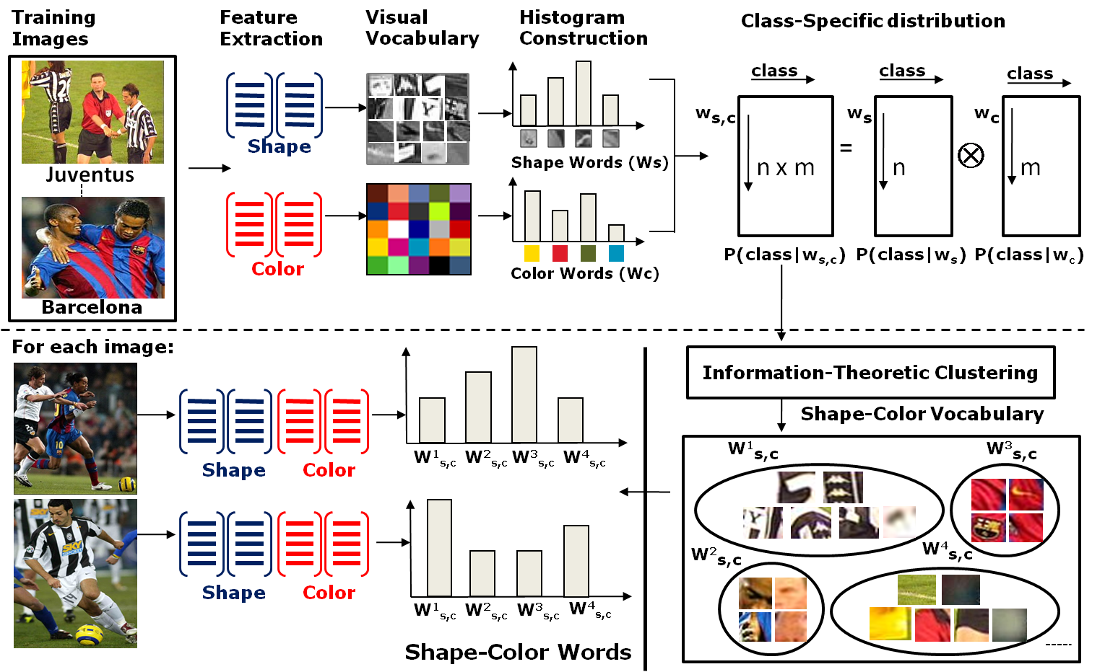
III: Portmanteau vocabularies
An efficient method to combine color and shape for image classification.
Portmanteau Vocabularies for Multi-Cue Image Representation, [Khan et al. 2011].

Slide 7
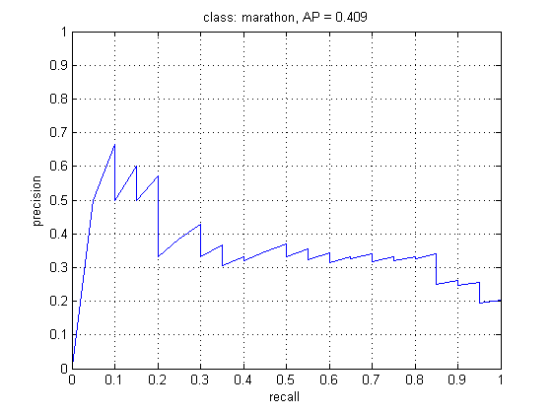
The mAP of the groups:
Try to analyze the behavior of the precision-recall curves.

Slide 8
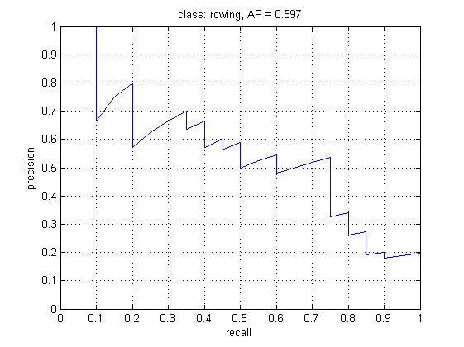
The mAP of the groups:
Try to analyze the behavior of the precision-recall curves.

Slide 9
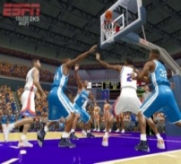
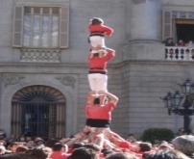
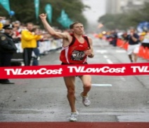
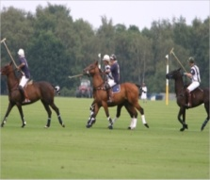
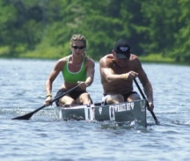
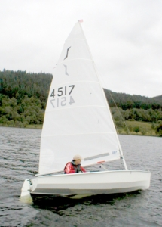
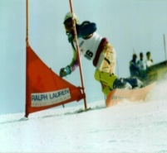
The mAP of the groups:
group 1 | 0.84 | 0.74 | 0.69 | 0.90 | 0.85 | 0.84 | 0.73
group 2 | 0.92 | 0.74 | 0.61 | 0.99 | 0.95 | 0.95 | 0.86
group 3 | 0.61 | 0.58 | 0.27 | 0.81 | 0.28 | 0.50 | 0.61
group 1: Eduard, Didier, Adria
group 2: Marta, Long Long, Francesca, Andrew
group 3: Ivet, Manuel, Sean

Slide 10
some remarks:
Everybody should understand the basic code.
Divide the tasks.
Explain each other what you are doing.
New Code:
- a fast normalize patch function (David Rojas)
http://cat.uab.es/~joost/master.html

